Slide 1
Sentiment Analysis on Amazon Product Reviews
By
Lakhan patidar
Sanjay kumars

Slide 2
Overview
Product Information
Web Scraping
Data Preprocessing
Visualizations of ratings
Text Preprocessing
CountVectorizer
Word Cloud
Sentiment Analysis
Model Building
Metrics

Slide 3

Product Information
Name: boAt Rockerz 370 Bluetooth Wireless
Link: Amazon link

Slide 4
Web Scraping
Web scrapped the data using beautifulsoup and requests
Gather the data of the 1st hundred pages
Retrieved 820 observations which includes rating, title and content
Libraries used
  BeautifulSoup
  Requests

Slide 5
Data Preprocessing
Performed data preprocessing by verifying any missing values and the distribution of the ratings
Created a new feature as ‘review’ by combining ‘title’ and ‘content’ and both are text features
Libraries used
  pandas

Slide 6
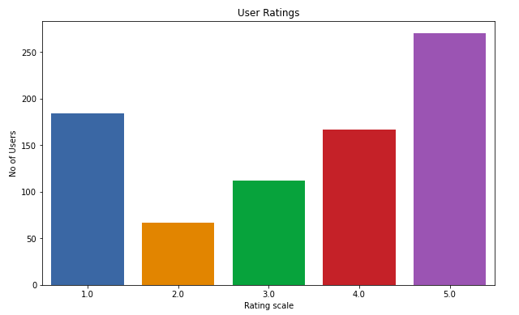
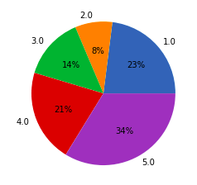
Visualizations of ratings
Libraries used
  Matplotlib
  seaborn

Slide 7
Text Preprocessing
Calculated the values counts of each review of the below parameters
  Char_count
  Punctuations
  Numerics
  stopwords
Removed the below parameters from the reviews
  Stopwords
  Emojis
  Rare words
Libraries used
  Pandas
  NLTK

